Slide 1
DESIGN OF LIGHTWEIGHT ENCRYPTION SCHEME FOR SECURE DATA COMMUNICATION IN UAVs
SUPERVISOR:
ENGR LAL SAID KHAN
PRESENTED BY:
HAMZA IRFAN & MAAZ JAMSHAID

Slide 2
PROJECT OBJECTIVES
LIGHTWEIGHT ENCRYPTION IN UAVs (Compared to Advanced Encryption Scheme)
Less Complex
Low Cost
Higher Throughput (AES has lower throughput)
SWAP (Size, Weight And Power)
DESIGN A STABLE CRYPTOSYSTEM (Analysis done in the 3rd Section)
High immunity to different attacks by the intruder

Slide 3
OUTLINE
Project Objectives
Encryption
Diffusion
Confusion
Decryption
Reverse Diffusion
Reverse Confusion
Security Analysis
Future Work
References

Slide 4
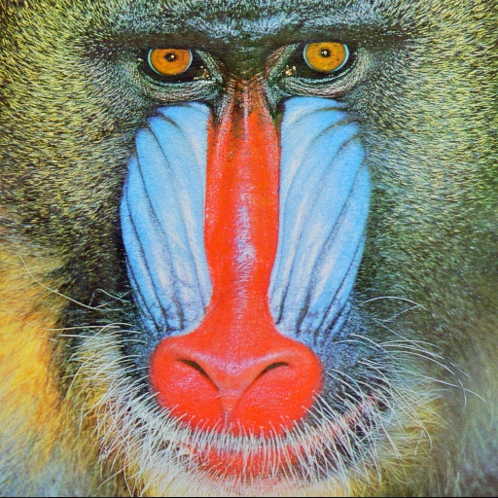

DATA SET
(A) BABOON
(B) LENA

Slide 5
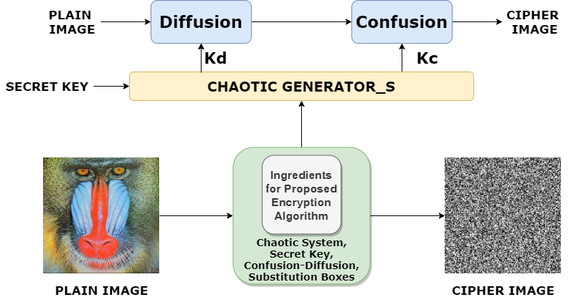
Security at the application layer: system level Diagram of encryption
SHUFFLING
SUBSTITUTION

Slide 6
ENCRYPTION (1)Diffusion

Slide 7
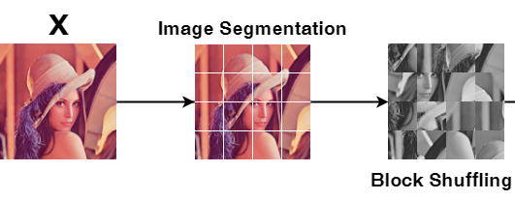
Diffusion (Shuffling)

Slide 8
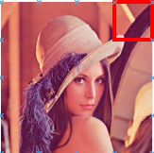
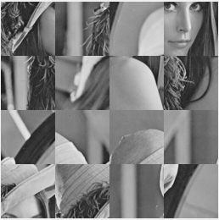
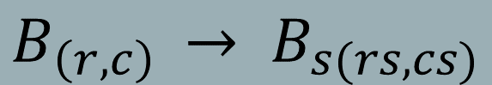
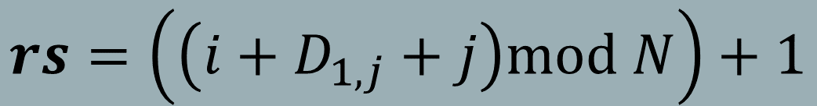
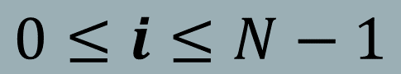

Diffusion Equation
$$B_{\left(r,c\right) }→ B_{s(rs,cs)}$$
$$rs=\left(\left(i+D_{1,j}+j\right)mod N\right)+1$$
$$cs=D_{rs,j}$$
$$0≤i≤N−1$$
r = row
c = column
N = Size of Image (4x4)
D = Key Matrix
rs = row of shuffled Img
cs = column of shuffled Img

Slide 9
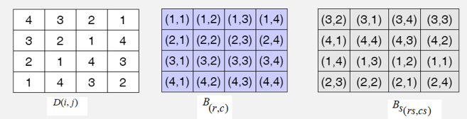
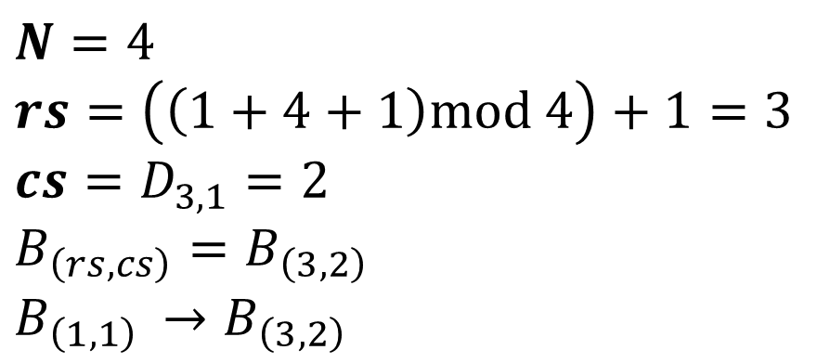
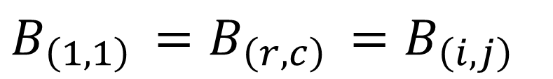
Diffusion example
$$B_{\left(1,1\right) }=B_{\left(r,c\right) }=B_{\left(i,j\right) }$$
KEY MATRIX
$$N=4$$
$$rs=\left(\left(1+4+1\right)mod 4\right)+1=3$$
$$cs=D_{3,1}=2$$
$$B_{\left(rs,cs\right)}=B_{\left(3,2\right) }$$
$$B_{\left(1,1\right) }→B_{\left(3,2\right) }$$
SHUFFLED IMAGE

Slide 10
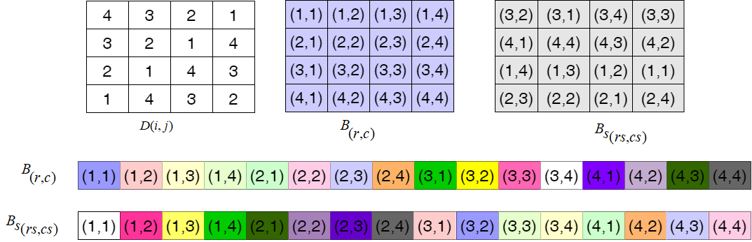
Diffusion

Slide 11
Diffusion
Plain Image
Diffused image

Slide 12
ENCRYPTION (2)Confusion

Slide 13
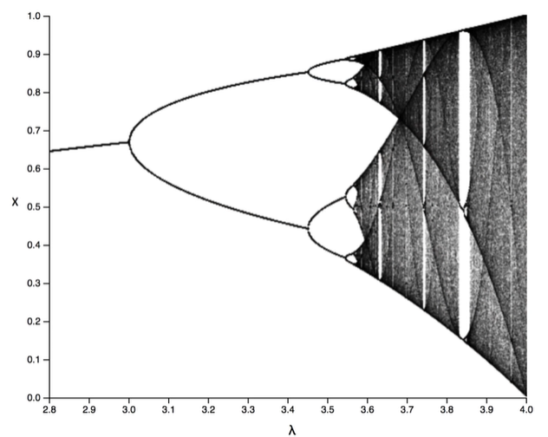
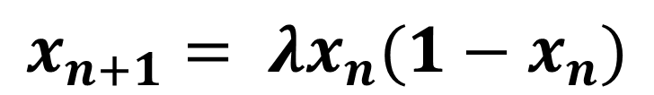
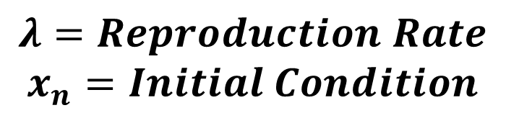
Logistic chaotic map
$$λ=Reproduction Rate$$
$$x_{n}=Initial Condition$$
$$x_{n+1}= λx_{n}(1−x_{n})$$

Slide 14
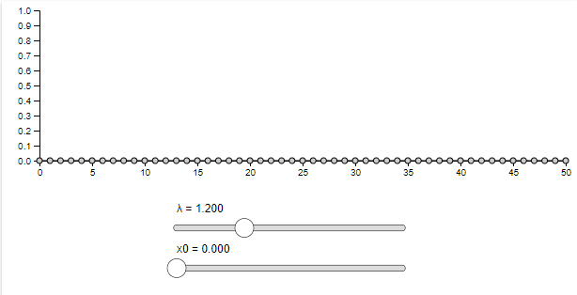
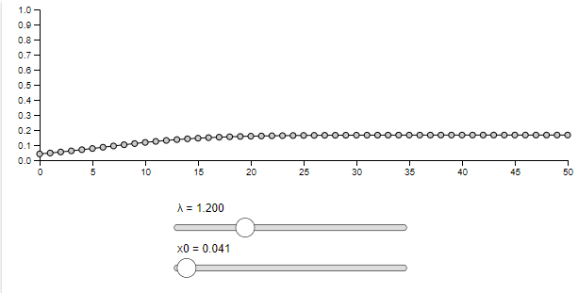
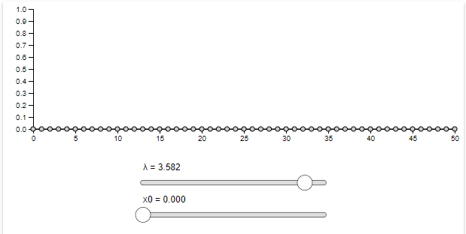
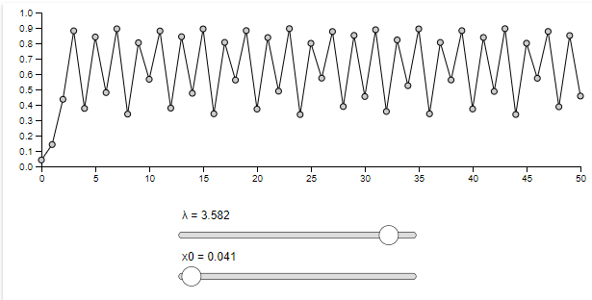
LOGISTIC CHAOTIC MAP
https://www.complexity-explorables.org/flongs/logistic/

Slide 15
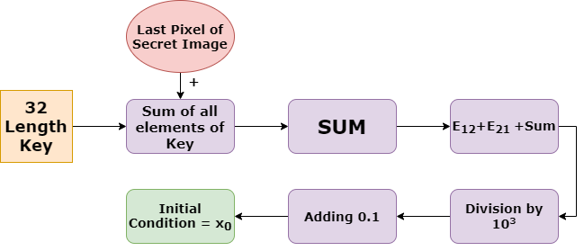
Initializing parameters for logistic chaotic map

Slide 16
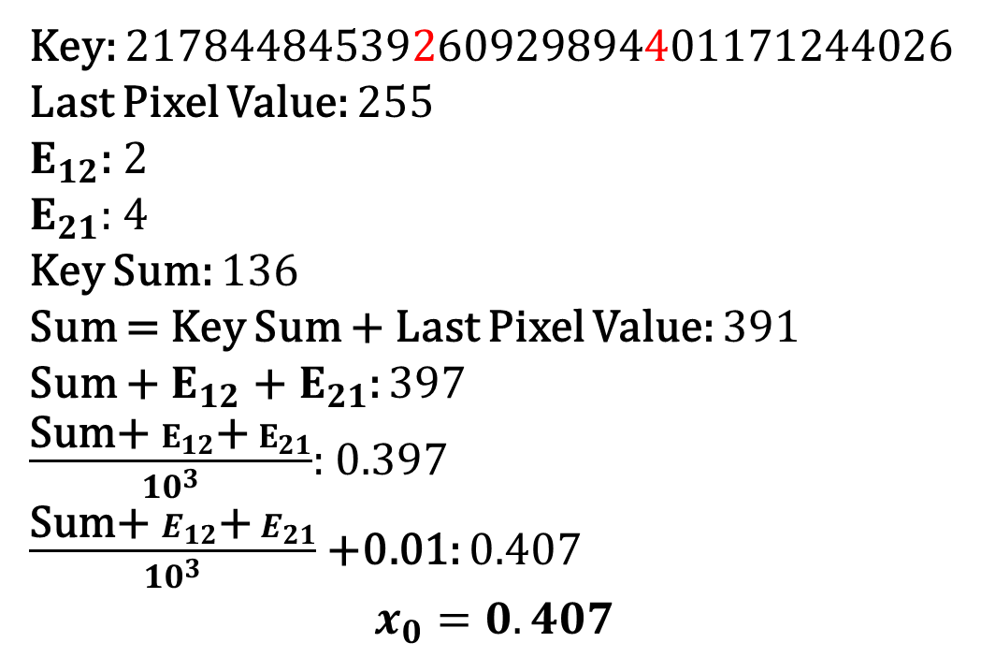
Initializing parameters for logistic chaotic map
Key: 21784484539260929894401171244026
Last Pixel Value: 255
$E_{12}$: 2
$E_{21}:$ 4
Key Sum: 136
Sum = Key Sum + Last Pixel Value: 391
Sum + $E_{12}$ +${ E}_{21}$: 397
$\frac{\text{Sum}\text{+ }E_{12}\text{+}{ E}_{21}}{{10}^{3}}$: 0.397
$\frac{\text{Sum}\text{+ }E_{12}\text{+}{ E}_{21}}{{10}^{3}}$ +0.01: 0.407
$$x_{0}=0.407$$

Slide 17
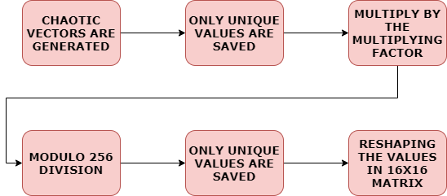
S-box Generation Algorithm

Slide 18
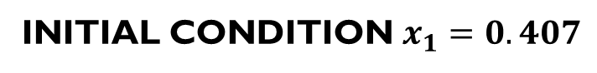
S-box
INITIAL CONDITION $x_{1}=0.407$
156 | 4 | 108 | 213 | 61 | 166 | 14 | 119 | 223 | 72 | 176 | 25 | 129 | 160 | 90 | 225
130 | 234 | 83 | 187 | 36 | 140 | 245 | 93 | 198 | 46 | 151 | 255 | 104 | 109 | 39 | 252
105 | 209 | 57 | 162 | 10 | 115 | 219 | 68 | 172 | 21 | 125 | 230 | 78 | 58 | 15 | 201
79 | 184 | 32 | 136 | 241 | 89 | 194 | 42 | 147 | 251 | 100 | 204 | 53 | 85 | 220 | 150
54 | 158 | 7 | 111 | 215 | 64 | 168 | 17 | 121 | 226 | 74 | 179 | 27 | 34 | 169 | 99
28 | 133 | 237 | 86 | 190 | 38 | 143 | 247 | 96 | 200 | 49 | 153 | 2 | 239 | 118 | 48
3 | 107 | 212 | 60 | 165 | 13 | 117 | 222 | 70 | 175 | 23 | 128 | 232 | 188 | 67 | 75
233 | 82 | 186 | 35 | 139 | 244 | 92 | 196 | 45 | 149 | 254 | 102 | 207 | 137 | 94 | 24
208 | 56 | 161 | 9 | 114 | 218 | 66 | 171 | 19 | 124 | 228 | 77 | 181 | 164 | 43 | 229
182 | 31 | 135 | 240 | 88 | 193 | 41 | 145 | 250 | 98 | 203 | 51 | 183 | 113 | 248 | 178
157 | 5 | 110 | 214 | 63 | 167 | 16 | 120 | 224 | 73 | 177 | 26 | 132 | 62 | 197 | 127
131 | 236 | 84 | 189 | 37 | 142 | 246 | 95 | 199 | 47 | 152 | 0 | 81 | 11 | 146 | 154
106 | 210 | 59 | 163 | 12 | 116 | 221 | 69 | 174 | 22 | 126 | 231 | 30 | 216 | 173 | 103
80 | 185 | 33 | 138 | 242 | 91 | 195 | 44 | 148 | 253 | 101 | 205 | 235 | 243 | 122 | 52
55 | 159 | 8 | 112 | 217 | 65 | 170 | 18 | 123 | 227 | 76 | 180 | 6 | 192 | 71 | 1
29 | 134 | 238 | 87 | 191 | 40 | 144 | 249 | 97 | 202 | 50 | 155 | 211 | 141 | 20 | 206

Slide 19
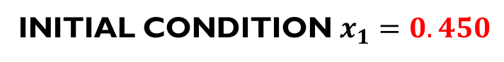
S-box comparison
INITIAL CONDITION $x_{1}=0.450$
198 | 46 | 151 | 0 | 104 | 209 | 58 | 162 | 11 | 116 | 220 | 69 | 51 | 163 | 146 | 108
172 | 21 | 125 | 230 | 79 | 183 | 32 | 137 | 242 | 90 | 195 | 44 | 129 | 112 | 95 | 57
147 | 251 | 100 | 205 | 53 | 158 | 7 | 111 | 216 | 65 | 169 | 18 | 78 | 61 | 122 | 33
121 | 226 | 74 | 179 | 28 | 133 | 237 | 86 | 191 | 39 | 144 | 249 | 27 | 139 | 71 | 238
96 | 200 | 49 | 154 | 2 | 107 | 212 | 60 | 165 | 14 | 119 | 223 | 54 | 88 | 98 | 9
70 | 175 | 24 | 128 | 233 | 82 | 186 | 35 | 140 | 244 | 93 | 20 | 3 | 37 | 47 | 214
45 | 149 | 254 | 103 | 207 | 56 | 161 | 10 | 114 | 219 | 68 | 225 | 208 | 64 | 23 | 241
19 | 124 | 229 | 77 | 182 | 31 | 135 | 240 | 89 | 193 | 42 | 174 | 30 | 13 | 228 | 190
250 | 99 | 203 | 52 | 157 | 5 | 110 | 215 | 63 | 168 | 17 | 252 | 235 | 218 | 255 | 166
224 | 73 | 178 | 26 | 131 | 236 | 84 | 189 | 38 | 143 | 247 | 201 | 184 | 40 | 204 | 115
199 | 48 | 152 | 1 | 106 | 210 | 59 | 164 | 12 | 117 | 222 | 150 | 6 | 245 | 231 | 142
173 | 22 | 127 | 232 | 80 | 185 | 34 | 138 | 243 | 92 | 196 | 177 | 211 | 194 | 180 | 91
148 | 253 | 101 | 206 | 55 | 159 | 8 | 113 | 217 | 66 | 171 | 126 | 160 | 16 | 156 | 118
123 | 227 | 76 | 181 | 29 | 134 | 239 | 87 | 192 | 41 | 145 | 75 | 187 | 221 | 105 | 67
97 | 202 | 50 | 155 | 4 | 109 | 213 | 62 | 167 | 15 | 120 | 153 | 136 | 170 | 132 | 43
72 | 176 | 25 | 130 | 234 | 83 | 188 | 36 | 141 | 246 | 94 | 102 | 85 | 197 | 81 | 248

Slide 20
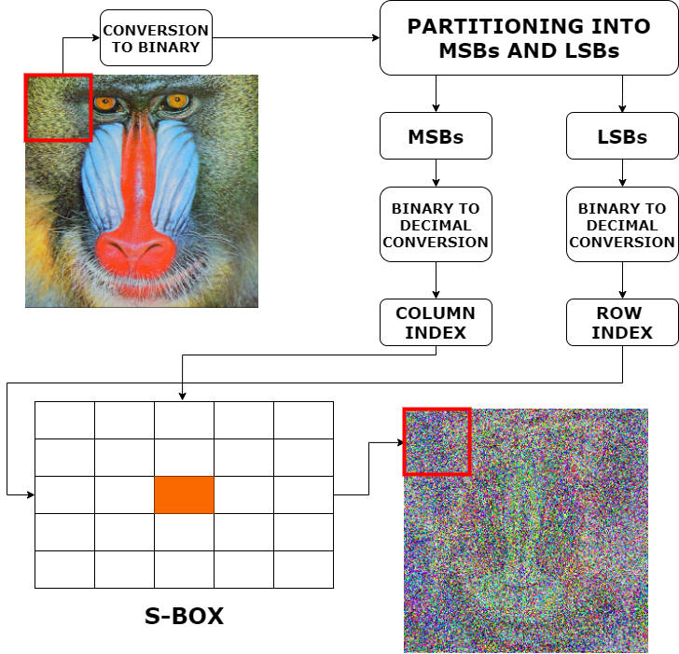
Substitution using S‑boxes Algorithm

Slide 21
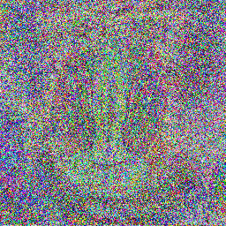
Substitution/confusion
Plain image
CONFUSED IMAGE

Slide 22
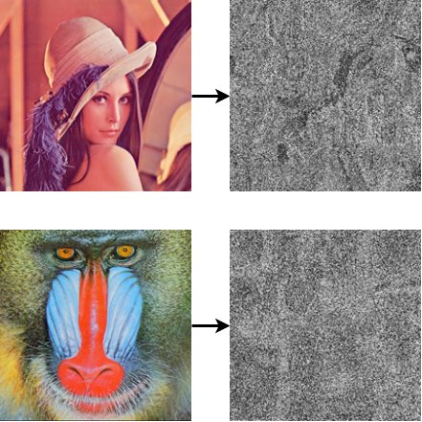
Complete encryption(C+D) Results

Slide 23
DECRYPTION

Slide 24
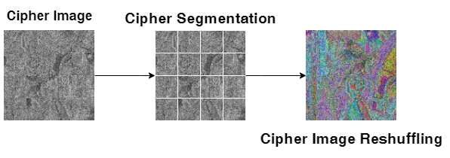
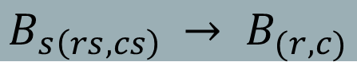
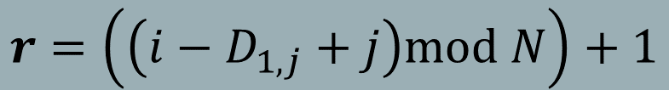
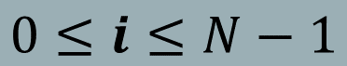
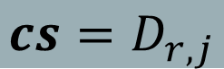
Reverse diffusion Algorithm
$$B_{s\left(rs,cs\right) }→ B_{(r,c)}$$
$$r=\left(\left(i−D_{1,j}+j\right)mod N\right)+1$$
$$cs=D_{r,j}$$
$$0≤i≤N−1$$

Slide 25
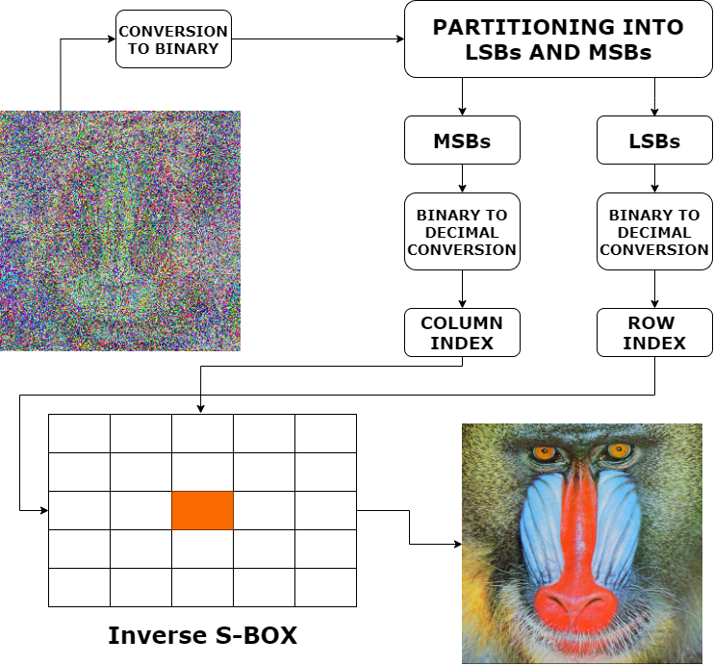
Reverse Confusion Algorithm

Slide 26
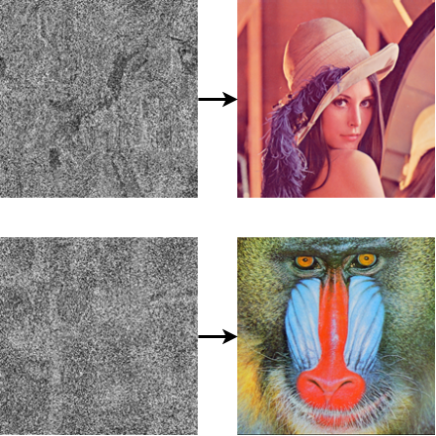
Complete decryption results

Slide 27
Security analysis

Slide 28
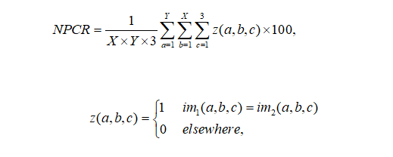
Differential analysis
Against Differential Attack

Slide 29
Differential analysis
NPCR > 0.99
Differential analysis of the implemented scheme
IMAGE | NPCR
Baboon | 0.9948
Lena | 0.9959

Slide 30
Comparison with state-of-the-art cryptosystem
Our system outperforms one of their cryptosystems
IMAGE | LENA
Yi et al. | 0.9962
Abdullah et al. | 0.9957
Implemented | 0.9959

Slide 31
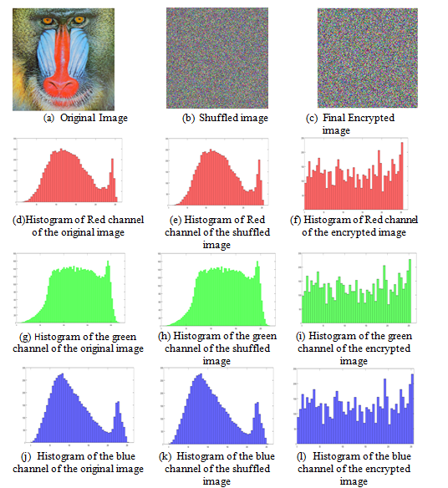
Histogram Analysis

Slide 32
Correlation Coefficient analysis
Correlation Based Analysis of selected Original images from the databases and Encrypted images using the Implemented Technique
IMAGE | ORIGINAL vs ORIGINAL |  |  | ORIGINAL vs ENCRYPTED
 | Vertical | Horizontal | Diagonal | Vertical | Horizontal | Diagonal
BABOON | 0.826108 | 0.87367 | 0.7843303 | 0.003892 | 0.0035843 | 0.0026529
LENA | 0.97266 | 0.94555 | 0.92130 | 0.00274938 | 0.0000223 | 0.0006788

Slide 33
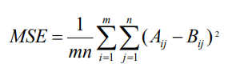
Mean Square Error Analysis

Slide 34
Mean square error Analysis
MSE analysis of Original image and Decrypted Image
 | BABOON |  |  | LENA
 | R | G | B | R | G | B
MSE | 0.2122 | 0.3313 | 0.3621 | 0.2231 | 0.2263 | 0.1624

Slide 35
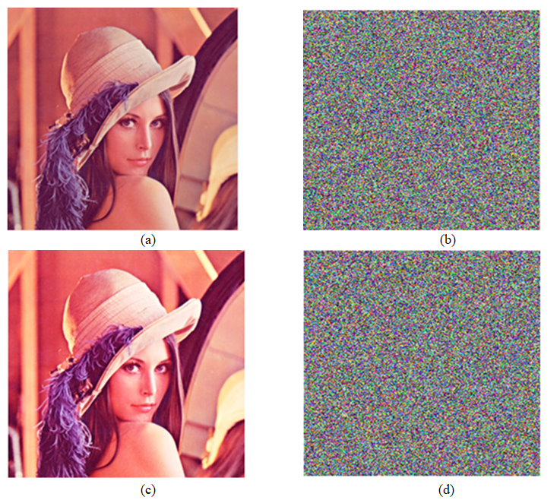
Key Sensitivity Analysis

Slide 36
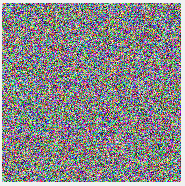
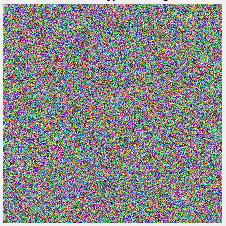
COMPARISON FOR KEY SENSITIVITY
Correlation = ~ 0.003

Slide 37
Key Space Analysis
In the case of the logistic chaotic map, the chaotic behavior can be observed for 3.5<λ<4.
There are infinite values between 3.5 and 4. So the key space is infinite and the intruder will have to test all the possible keys for the brute-force attack.

Slide 38
Time analysis
Time analysis is done using tic toc command in MATLAB 2018b on AMD A10-7400P Radeon R6, 10 Compute Cores 4C+6G 2.50 GHz with Windows 10
IMAGE | TIME FOR Lightweight ENCRYPTION (seconds) | TIME FOR AES ENCRYPTION (seconds)
Lena | 9.967376 | 209.142729 (~3.48 min)
Baboon | 10.520381 | 213.368554 (~3.55 min)

Slide 39
Future work
Implementing this cryptosystem on FPGA or high-end GPUs such as new OpenGL extensions provided by NVIDIA in the GeForce 8 Series
Cryptosystems can be used in IoT devices as they transfer massive amounts of data worth securing

Slide 40
References
Copyright 2001-2005, J. J. Buchholz, Hochschule Bremen, buchholz@hs-bremen.de
https://www.researchgate.net/publication/346446212_AES_Encryption_Study_Evaluation
https://link.springer.com/content/pdf/10.1007/s11042-022-13078-6.pdf
https://www.complexity-explorables.org/flongs/logistic/
Wu, Y., Noonan, J. P., & Agaian, S. NPCR and UACI randomness tests for image encryption. on Journal of Selected Areas in Telecommunications (JSAT), 31-38. 2011. (http://www.cyberjournals.com/Papers/Apr2011/05.pdf)
He Y, Zhang YQ, Wang XY (2020) A new image encryption algorithm based on two-dimensional spatiotemporal chaotic system. Neural Comput & Applic 32:247–260
Alghafis A, Firdousi F, Batool SI, Amin M (2020) An efficient image encryption scheme based on chaotic and deoxyribonucleic acid sequencing. Mathematics and Computers in Simulation (MATCOM), Elsevier 177, no. C: 441–466
http://sites.google.com/site/athisnarayanan/
https://www.sciencedirect.com/science/article/pii/S1877050913006327

Slide 41
THANKYOU

